Slide 1
Chapter: Handling of character strings

Slide 2
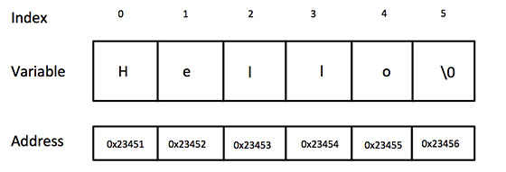
Introduction to string
String is a sequence of characters enclosed in double quotes.
Normally, it is used for storing data like name, address, city etc.
ASCII code is internally used to represent string in memory.
In ‘C’, each string is terminated by a special character called null character represented as ‘\0’ or NULL.
Because of this reason, the character array must be declared one size longer than the string required to be stored.
char greeting[6] = {'H', 'e', 'l', 'l', 'o', '\0'};
char greeting[] = "Hello";

Slide 3
Reading strings
The format specifier %s is used to read a string in the character array.
For example,
char name[20];
scanf(“%s”,&name); OR gets(name);
Unlike previous scanf calls, in the case of character arrays, the ampersand (&) is not required before the variable name.
The advantage of gets( ) is that we can read string involving blanks, tabs. While the scanf( ) reads only upto blank or tab character. So, scanf( ) is used to read word while gets( ) can be used read sentence involving many words.

Slide 4
printing strings
The format specifier %s is used to print a string in the character array.
For example,
char name[ ] = “Hello”;
printf(“%s”,name); OR puts(name);
puts( ) can print only one string at a time, while one printf( ) can print multiple strings by using %s many times in the printf( ).
char name[ ] = “ABC”;
char surname[ ] = “XYZ”;
printf(“%s %s”, name, surname); OR
puts(name);
puts(surname);

Slide 5
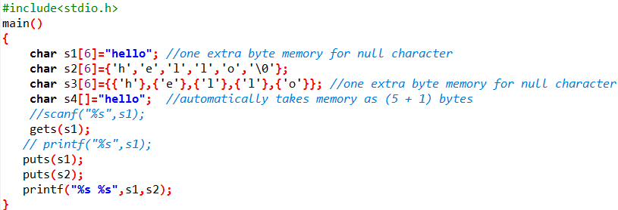

Slide 6
Arithmetic operations on characters
To write a character in its integer representation, we may write it as an integer. For example, if the machine uses the ASCII representation, then,
x = ‘a’;
printf(“%d \n”, x);
will display the number 97 on the screen.
It is possible to perform arithmetic operations on the character constants and variables. For example,
x = ‘z’ – 1
This is a valid statement. In ASCII, the value of ‘z’ is 122, and therefore, the statement will assign the value 121 to the variable x.
We may also use character constants in relational expressions. For example,
ch >= ‘A’ && ch <= ‘Z’

Slide 7
Distinction between characters and strings
The representation of a char (e.g., ‘Q’) and a string (e.g., “Q”) is essentially different.
A string is an array of characters ended with the null character.
Q → Character ‘Q’
Q \0 → String “Q”

Slide 8
String manipulation functions
Sr. No | String function | Syntax | Explanation
1. | strlen( ) | strlen(s1) | Gives the length of input string (s1).
2. | strcpy( ) | strcpy(dest, source) | Copies source string into destination string.
3. | strncpy( ) | strncpy(dest, source,n) | Copies given number of characters (n) of source string to destination string.
4. | strcat( ) | strcat(s1, s2) | Concatenates s2 at the end of s1.
5 | strncat( ) | strncat(s1, s2,n) | Appends portion of s2 at the end of s1 as specified by n.
6. | strcmp( ) | strcmp(s1, s2) | Returns 0 if s1 is same as s2. Returns < 0 if s1 < s2. Returns > 0 if s1 > s2. Is case-sensitive.
7. | strcmpi( ) | strcmpi(s1, s2) | Same as strcmp( ) function. But, this function negotiates case. “A” and “a” are treated as same. Is case-insensitive.
8. | strncmp( ) | strncmp(s1, s2, n) | It compares both the string till n characters or in other words it compares first n characters of both the strings.
9. | strnicmp( ) | strnicmp(s1, s2, n) | Same as strncmp( ). But is case insensitive.
10. | strrev( ) | strrev(s1) | Returns the reverse of the string.

Slide 9

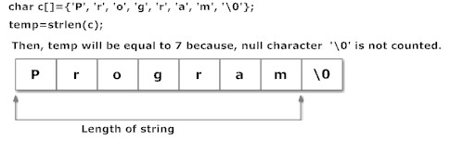
strlen( )
In C, strlen() function calculates the length of string. It is defined under "string.h" header file.
It takes only one argument, i.e, string name.
Syntax of strlen() →
Function strlen() returns the value of type integer.

Slide 10
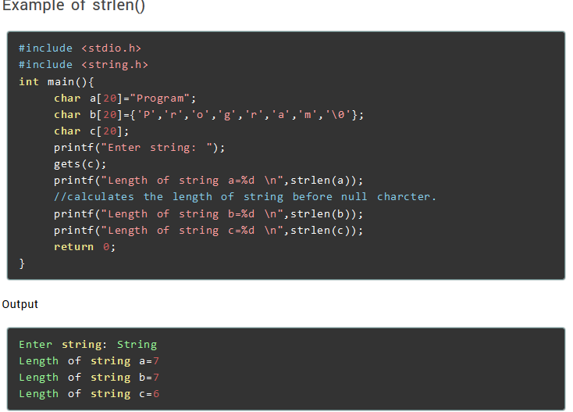
strlen( )

Slide 11
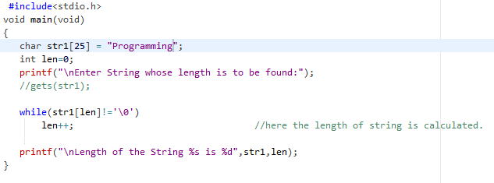

Finding length of string without using strlen( )

Slide 12
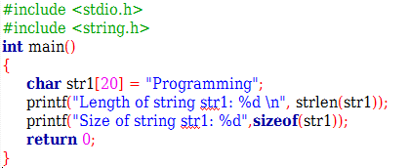
strlen vs sizeof
strlen returns you the length of the string stored in array, however sizeof returns the total allocated size assigned to the array. Consider the given example, then the following statements would return the below values.
strlen(str1) returned value 11.
sizeof(str1) would return value 20 as the array size is 20 (see the first statement in main function).

Slide 13

strcpy( )
Function strcpy() copies the content of one string to the content of another string. It is defined under "string.h" header file.
It takes two arguments.
Syntax of strcpy() →
Here, source and destination are both the name of the string. This statement, copies the content of string source to the content of string destination.

Slide 14
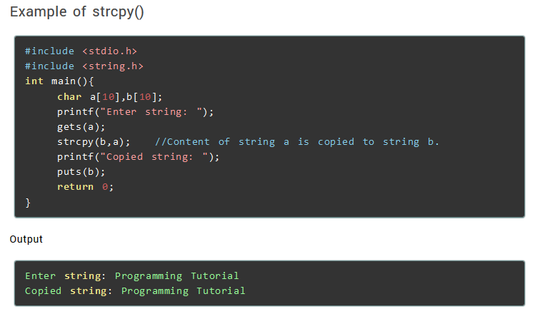
strcpy( )

Slide 15
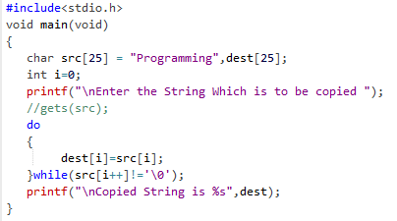

Copy one string to another without using strcpy( )

Slide 16
strncpy( )
Function strncpy() copies the content of one string to the content of another string by specifying the number of characters to copy. It is defined under "string.h" header file.
It takes two arguments.
Syntax of strncpy() → strncpy(dest, src, n);
After using this function, you need to manually put null character at the end of destination string → dest[n] = ‘\0’;
Here, source and destination are both the name of the string. This statement, copies the content of string source to the content of string destination.

Slide 17
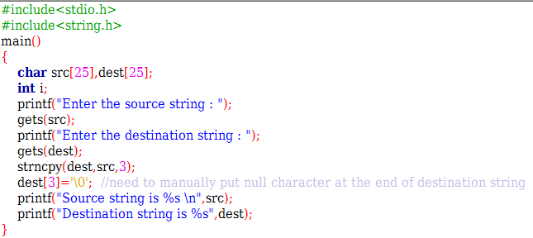
strncpy( )

Slide 18
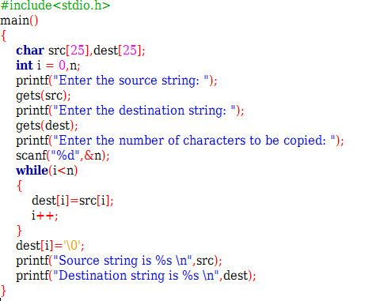
Copy a string without using strncpy( )

Slide 19
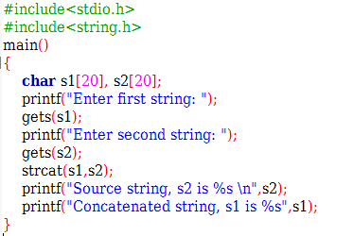
strcat( )
In C programming, strcat() concatenates(joins) two strings.
It takes two arguments, i.e, two strings and resultant string is stored in the first string specified in the argument.
Function strcat() is defined under "string.h" header file.
Syntax of strcat()
strcat(first_string,second_string);

Slide 20
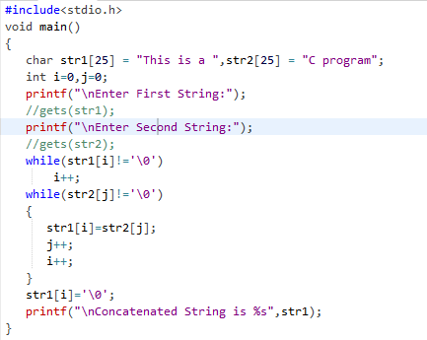

Concatenate two strings without using strcat( )

Slide 21
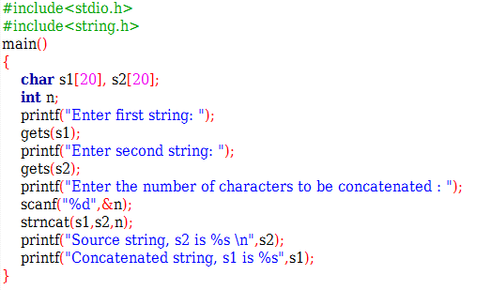
strncat( )
It concatenates n characters of str2 to string str1. A terminator char (‘\0’) will always be appended at the end of the concatenated string.

Slide 22
strcmp( )
C does not permit the comparison of two strings directly. That is, the statements such as
if (name1 == name2)
if (name1 == “ABC”) are not permitted. It is therefore necessary to compare the two strings to be tested, character by character. The comparison is done until there is a mismatch or one of the strings terminates into a null character, whichever occurs first.
In C, strcmp() compares two string and returns value 0, if the two strings are equal. It is defined under "string.h" header file.
Function strcmp() takes two arguments, i.e, name of two string to compare.
Returns 0 if s1 and s2 are the same; less than 0 if s1<s2; greater than 0 if s1>s2.
Syntax of strcmp()
temp_variable = strcmp(str1, str2);

Slide 23
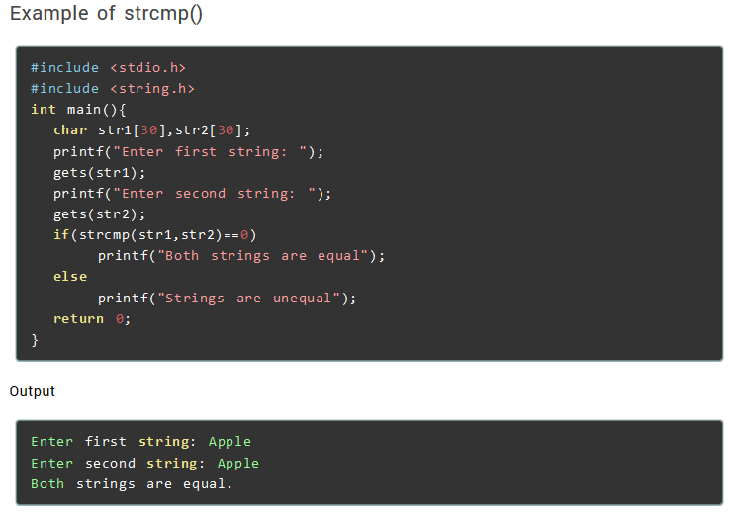
strcmp( )

Slide 24

strcmp( )
If two strings are not equal, strcmp() returns positive value i.e. 1 if ASCII value of first mismatching element of first string is greater than that of second string and negative value i.e. -1 if ASCII value of first mismatching element of first string is less than that of second string. For example:
Since, ASCII value of 'a' is less than that of 'c', variable temp will be negative.

Slide 25
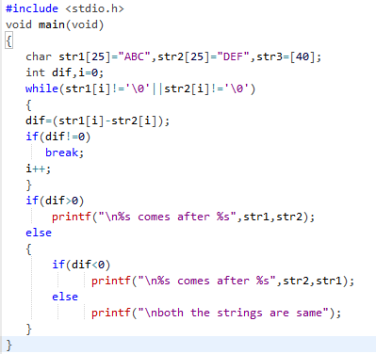

Compare two strings without using strcmp( )

Slide 26
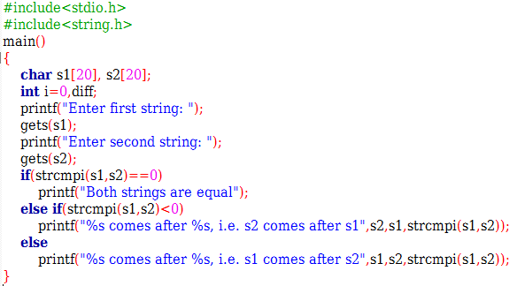
strcmpi( )
strcmpi( ) function in C is same as strcmp() function. But, strcmpi( ) function is not case sensitive. i.e, “A” and “a” are treated as same characters. Where as, strcmp() function treats “A” and “a” as different characters.

Slide 27
Some String programs
Write a program to find the frequency of a character entered by user in a string.
Write a program to compare case insensitive strings.
Write a program to swap character at odd positioned index with the one at even positioned index.
Write a program to find the total number of vowels, consonants, digits and spaces appearing in a string.
Write a program to remove all other characters in a string except the alphabets.
Write a program to calculate frequency of each character in a given string.
Write a program to sort strings in dictionary order.

Slide 28
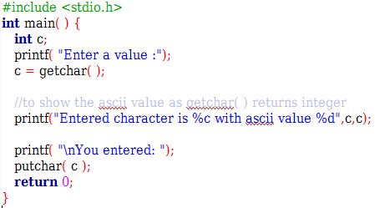
getchar( ) and putchar( )
The int getchar(void) function reads the next available character from the screen and returns it as an integer. This function reads only single character at a time.
The int putchar(int c) function puts the passed character on the screen and returns the same character. This function puts only single character at a time.

Slide 29
Difference between getchar() and getch()
If you use getchar(), you need to press enter key after entering the character in the console window. But, if you use getch(), you don’t need to press enter key after entering the character in the console window (Because it does not use any buffer, so the entered character is immediately returned without waiting for the enter key).
If you use getchar(), you can see the character that is being entered in the console window. But, if you use getch(), you can’t see the character that is being entered in the console window.

Slide 30
Character Analysis and Conversion
The <ctype.h> library defines facilities for character analysis and conversion.
Functions | Description
int isalnum(int c) | This function checks whether the passed character is alphanumeric.
int isalpha(int c) | This function checks whether the passed character is alphabetic.
int isdigit(int c) | This function checks whether the passed character is decimal digit.
int islower(int c) | This function checks whether the passed character is lowercase letter.
int isupper(int c) | This function checks whether the passed character is an uppercase letter.
int toupper(int c) | This function converts lowercase letters to uppercase.
int tolower(int c) | This function converts uppercase letters to lowercase.

Slide 31
getc() and putc() function
getc(), putc() functions are file handling function in C programming language which is used to read a character from a file (getc) and display on standard output or write into a file (putc).
getc() reads a single character from a given input stream and returns the corresponding integer value (typically ASCII value of read character) on success. It returns EOF on failure.
int getc(FILE *stream);
The difference between getc() and getchar() is getc() can read from any input stream, but getchar() reads from standard input. So getchar() is equivalent to getc(stdin).
The putc() function converts c to unsigned char and then writes c to the output stream at the current position. The putchar() is equivalent to putc(c, stdout).
int putc(int c, FILE *stream);

Slide 32
Thank you!!!

